Slide 1
Sales Performance Dashboard Superstore
Dashboard Design

Slide 2
Objective & Dataset
Objective: Build an interactive dashboard to track sales, profit, and customer performance.
Dataset: Kaggle Superstore dataset.
Key fields: Order Date, Sales, Profit, Category, Region, Customer Name.
Time period covered: 2018 – 2021 (based on dataset).

Slide 3
KPIs
Total Sales: 2.30M
Total Profit: 286.4K
Profit Margin: 12%
Average Order Value (AOV): 458.6

Slide 4
Dashboard Insights
Charts included:
Sales vs Profit (Scatter)
Sales by Region (Map)
Sales by Category (Bar Chart)
Top Customers Table
Insights:
Sales concentrated in Central region.
Technology and Furniture categories dominate sales.
Some categories show negative profits due to discounts.

Slide 5
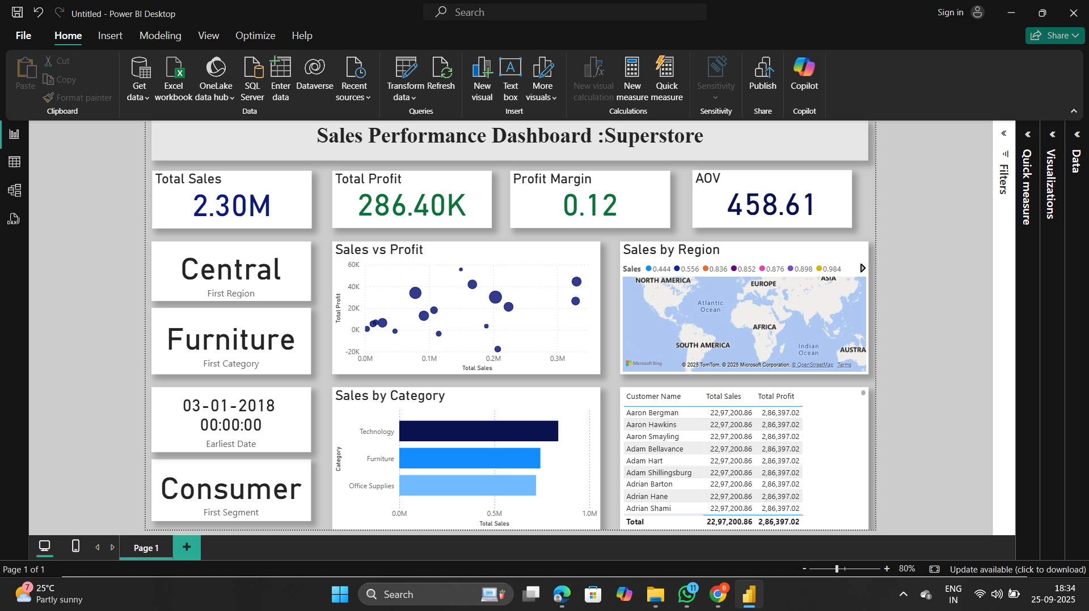

Slide 6
Recommendations
Focus on high-margin categories like Technology.
Revisit discount strategy for Furniture.
Strengthen relationships with top customers.
Xplore regional growth opportunities.

Slide 7
Thank you

